Slide 1

PROJECT :INVENTORY MANAGEMENT SYSTEM

Slide 2
Problem Statement
In the existing system of the mart everything was done manually but now mart is turning into a big supermarket.
The mart’s stockroom that contains all the products and goods is not well maintained.
There is no accurate record of the inventory.
There is no proper track of information of the employees. The wages of those employees, their holidays, perks, personal information, contact details, ID and etc.
It would be difficult to keep track of all the purchases the customer has made without a proper database.

Slide 3
Requirements Specification
Login functionality
Counter Billing.
Only Employees having the username and password will be able to perform CRUD operations on databases.
Advertise Customers
send sms/email to registered customers informing them of new products and/or deals, or unforeseen closures.
Adding suppliers and products records.
Smart Supply Chain Management
The application will keep track of the availability of all products in the store and can generate a purchase order.
Manual Supply Chain Management
Employees can also manually generate a purchase order due to any concerns.
Financial Reporting
Report profits and losses for specific period using graphs and charts.

Slide 4
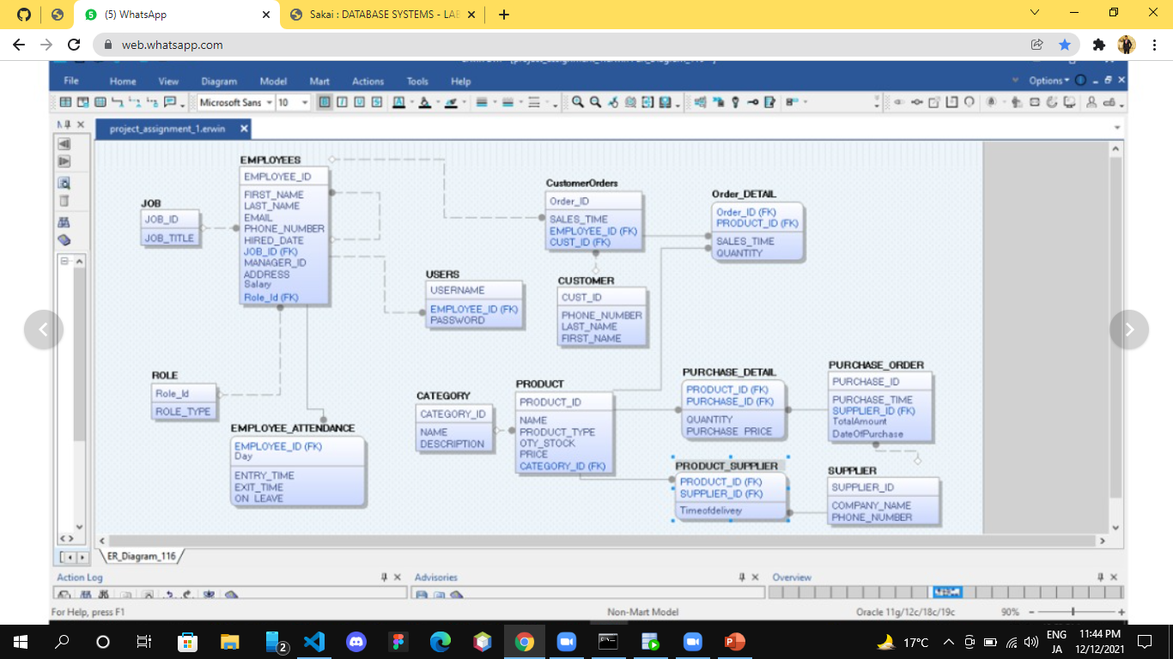
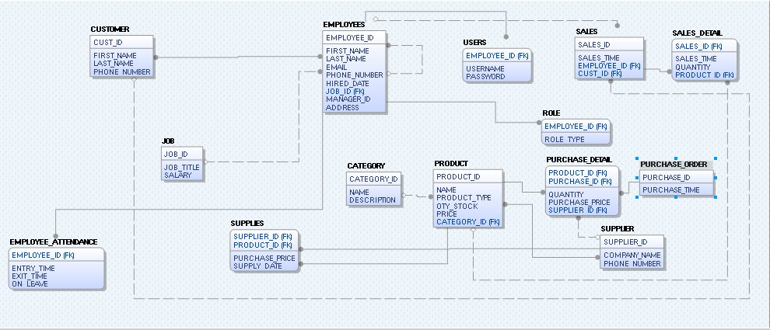
Logical model

Slide 5
Front-end pictures begins:

Slide 6
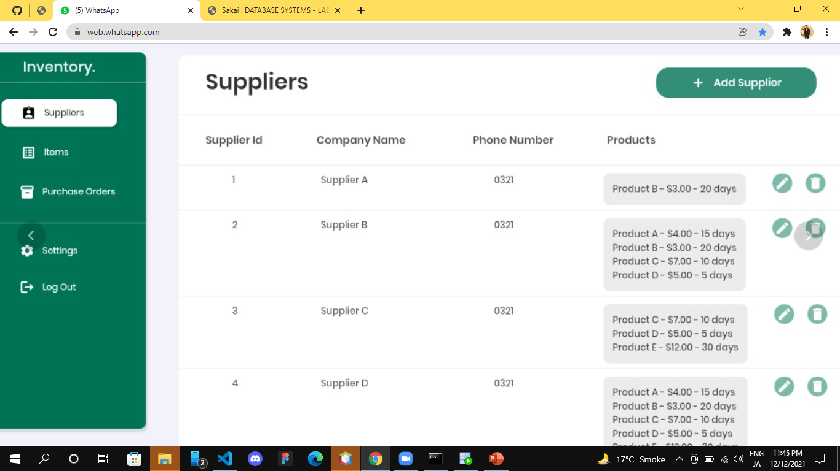

THANK YOU!
ANY QUESTIONS?

Slide 7
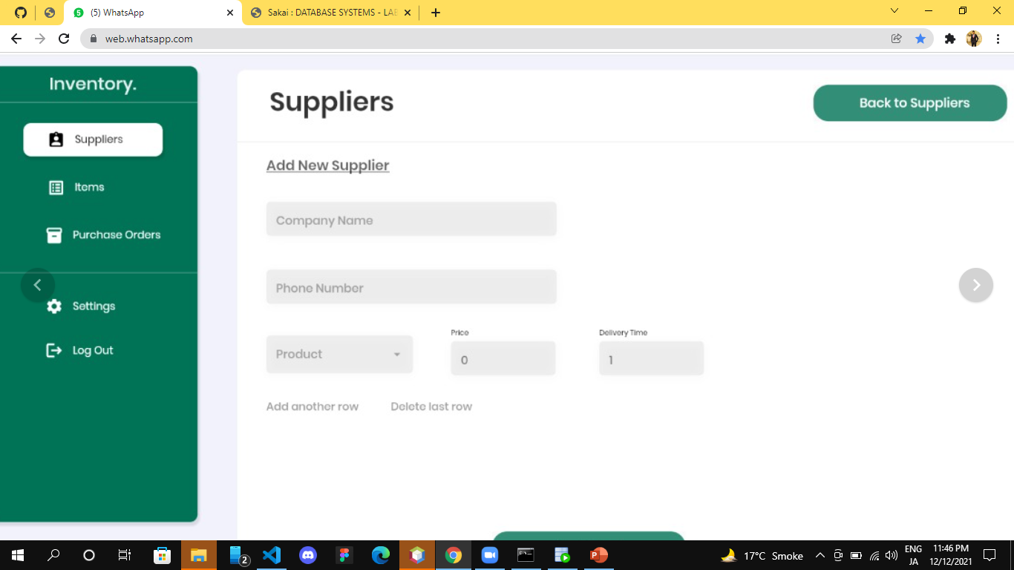

Slide 8
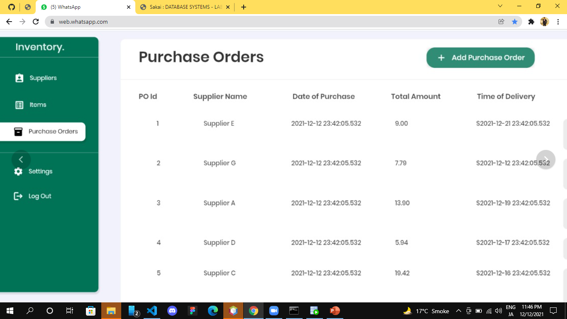

Slide 9
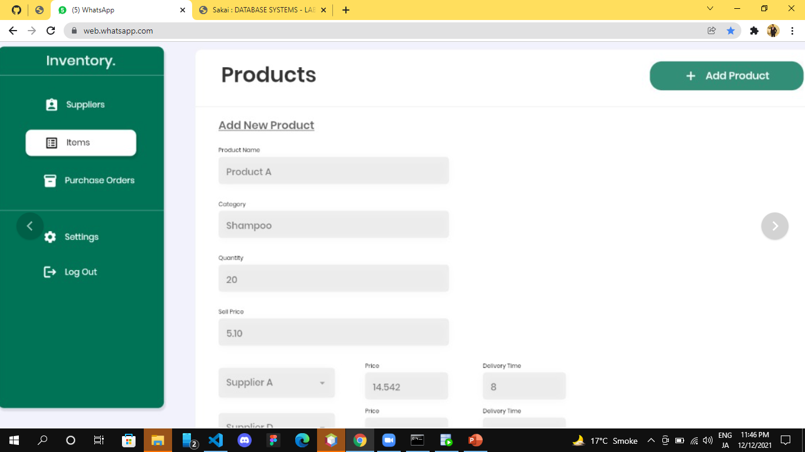

Slide 10
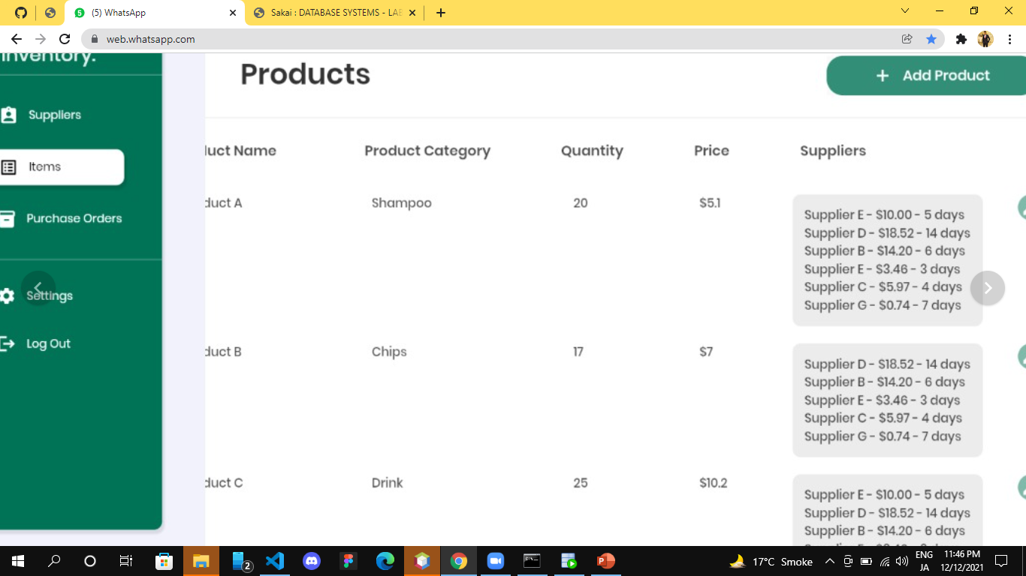

Slide 11
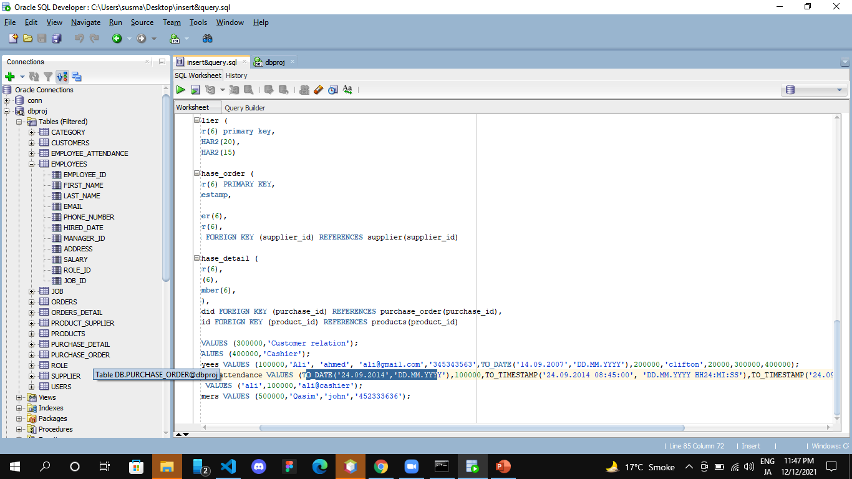

Slide 12
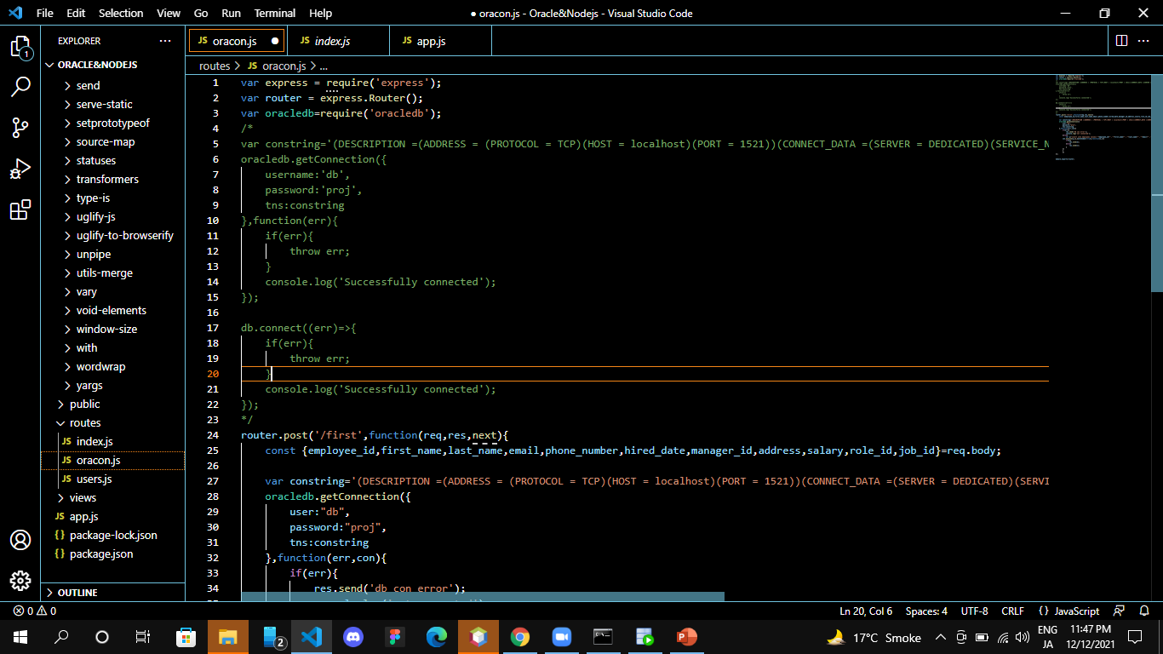
Nodejs connection

